Slide 1
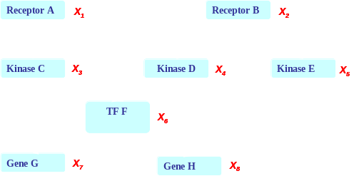
Conditional Random Fields
Probabilistic Graphical Models (10-708)
Ramesh Nallapati

Slide 2
Motivation:
Shortcomings of Hidden Markov Model
HMM models direct dependence between each state and only its corresponding observation
  NLP example: In a sentence segmentation task, segmentation may depend not just on a single word, but also on the features of the whole line such as line length, indentation, amount of white space, etc.
Mismatch between learning objective function and prediction objective function
  HMM learns a joint distribution of states and observations P(Y, X), but in a prediction task, we need the conditional probability P(Y|X)
Y₁
Y₂
…
…
…
Y_{n}
X₁
X₂
…
…
…
X_{n}

Slide 3
Solution:
Maximum Entropy Markov Model (MEMM)
Models dependence between each state and the full observation sequence explicitly
  More expressive than HMMs
Discriminative model
  Completely ignores modeling P(X): saves modeling effort
  Learning objective function consistent with predictive function: P(Y|X)
Y₁
Y₂
…
…
…
Y_{n}
X_{1:n}

Slide 4
MEMM: Label bias problem
Observation 1
Observation 2
Observation 3
Observation 4
State 1
0.4
0.45
0.5
0.2
0.6
0.2
0.55
0.1
0.5
State 2
0.2
0.3
0.3
0.2
0.1
0.2
State 3
0.2
0.1
0.2
State 4
0.2
0.3
0.2
State 5
What the local transition probabilities say:
  State 1 almost always prefers to go to state 2
  State 2 almost always prefer to stay in state 2

Slide 5
MEMM: Label bias problem
Observation 1
Observation 2
Observation 3
Observation 4
State 1
0.4
0.45
0.5
0.2
0.6
0.2
0.55
0.1
0.5
State 2
0.2
0.3
0.3
0.2
0.1
0.2
State 3
0.2
0.1
0.2
State 4
0.2
0.3
0.2
State 5
Probability of path 1-> 1-> 1-> 1:
0.4 x 0.45 x 0.5 = 0.09

Slide 6
MEMM: Label bias problem
Observation 1
Observation 2
Observation 3
Observation 4
State 1
0.4
0.45
0.5
0.2
0.6
0.2
0.55
0.1
0.5
State 2
0.2
0.3
0.3
0.2
0.1
0.2
State 3
0.2
0.1
0.2
State 4
0.2
0.3
0.2
State 5
Probability of path 2->2->2->2 :
0.2 X 0.3 X 0.3 = 0.018
Other paths:
1-> 1-> 1-> 1: 0.09

Slide 7
MEMM: Label bias problem
Observation 1
Observation 2
Observation 3
Observation 4
State 1
0.4
0.45
0.5
0.2
0.6
0.2
0.55
0.1
0.5
State 2
0.2
0.3
0.3
0.2
0.1
0.2
State 3
0.2
0.1
0.2
State 4
0.2
0.3
0.2
State 5
Probability of path 1->2->1->2:
0.6 X 0.2 X 0.5 = 0.06
Other paths:
1->1->1->1: 0.09
2->2->2->2: 0.018

Slide 8
MEMM: Label bias problem
Observation 1
Observation 2
Observation 3
Observation 4
State 1
0.4
0.45
0.5
0.2
0.6
0.2
0.55
0.1
0.5
State 2
0.2
0.3
0.3
0.2
0.1
0.2
State 3
0.2
0.1
0.2
State 4
0.2
0.3
0.2
State 5
Probability of path 1->1->2->2:
0.4 X 0.55 X 0.3 = 0.066
Other paths:
1->1->1->1: 0.09
2->2->2->2: 0.018
1->2->1->2: 0.06

Slide 9
MEMM: Label bias problem
Observation 1
Observation 2
Observation 3
Observation 4
State 1
0.4
0.45
0.5
0.2
0.6
0.2
0.55
0.1
0.5
State 2
0.2
0.3
0.3
0.2
0.1
0.2
State 3
0.2
0.1
0.2
State 4
0.2
0.3
0.2
State 5
Most Likely Path: 1-> 1-> 1-> 1
Although locally it seems state 1 wants to go to state 2 and state 2 wants to remain in state 2.
why?

Slide 10
MEMM: Label bias problem
Observation 1
Observation 2
Observation 3
Observation 4
State 1
0.4
0.45
0.5
0.2
0.6
0.2
0.55
0.1
0.5
State 2
0.2
0.3
0.3
0.2
0.1
0.2
State 3
0.2
0.1
0.2
State 4
0.2
0.3
0.2
State 5
Most Likely Path: 1-> 1-> 1-> 1
State 1 has only two transitions but state 2 has 5:
  Average transition probability from state 2 is lower

Slide 11
MEMM: Label bias problem
Observation 1
Observation 2
Observation 3
Observation 4
State 1
0.4
0.45
0.5
0.2
0.6
0.2
0.55
0.1
0.5
State 2
0.2
0.3
0.3
0.2
0.1
0.2
State 3
0.2
0.1
0.2
State 4
0.2
0.3
0.2
State 5
Label bias problem in MEMM:
Preference of states with lower number of transitions over others

Slide 12
Solution:
Do not normalize probabilities locally
Observation 1
Observation 2
Observation 3
Observation 4
State 1
0.4
0.45
0.5
0.2
0.6
0.2
0.55
0.1
0.5
State 2
0.2
0.3
0.3
0.2
0.1
0.2
State 3
0.2
0.1
0.2
State 4
0.2
0.3
0.2
State 5
From local probabilities ….

Slide 13
Solution:
Do not normalize probabilities locally
Observation 1
Observation 2
Observation 3
Observation 4
State 1
20
30
5
10
30
20
20
10
5
State 2
20
30
30
10
10
20
State 3
20
10
20
State 4
20
30
20
State 5
From local probabilities to local potentials
States with lower transitions do not have an unfair advantage!

Slide 14
From MEMM ….
Y₁
Y₂
…
…
…
Y_{n}
X_{1:n}

Slide 15
From MEMM to CRF
CRF is a partially directed model
  Discriminative model like MEMM
  Usage of global normalizer Z(x) overcomes the label bias problem of MEMM
  Models the dependence between each state and the entire observation sequence (like MEMM)
Y₁
Y₂
…
…
…
Y_{n}
x_{1:n}

Slide 16
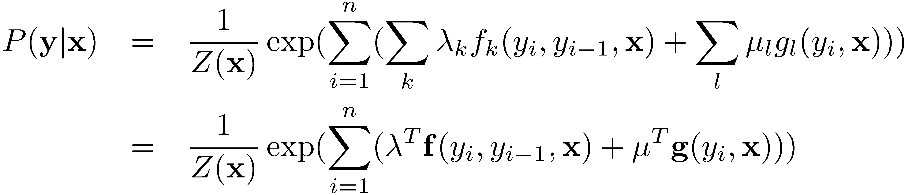
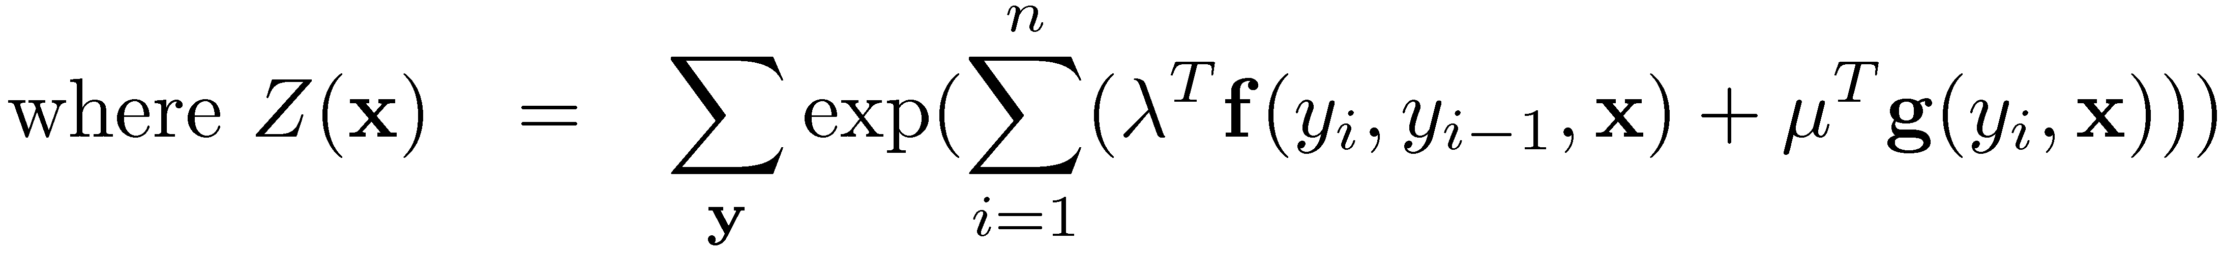
Conditional Random Fields
General parametric form:
Y₁
Y₂
…
…
…
Y_{n}
x_{1:n}

Slide 17
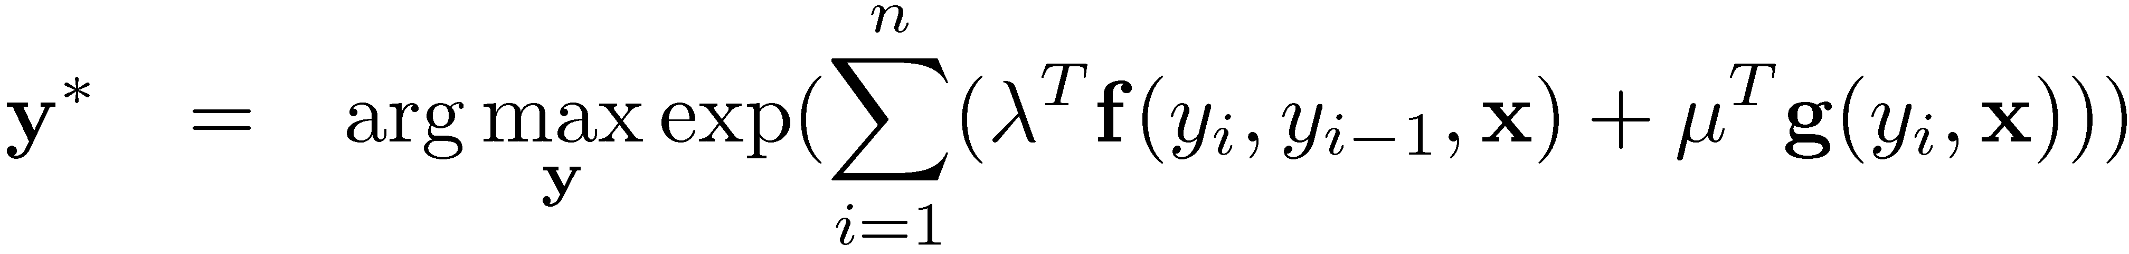
CRFs: Inference
Given CRF parameters λ and μ, find the y* that maximizes P(y|x)
  Can ignore Z(x) because it is not a function of y
Run the max-product algorithm on the junction-tree of CRF:
Y₁
Y₂
…
…
…
Y_{n}
x_{1:n}
Same as Viterbi decoding used in HMMs!
Y₁,Y₂
Y₂,Y₃
…….
Y_{n-2}
Y_{n-2},Y_{n-1}
Y_{n-1}
Y_{n-1},Y_{n}
Y₂
Y₃

Slide 18
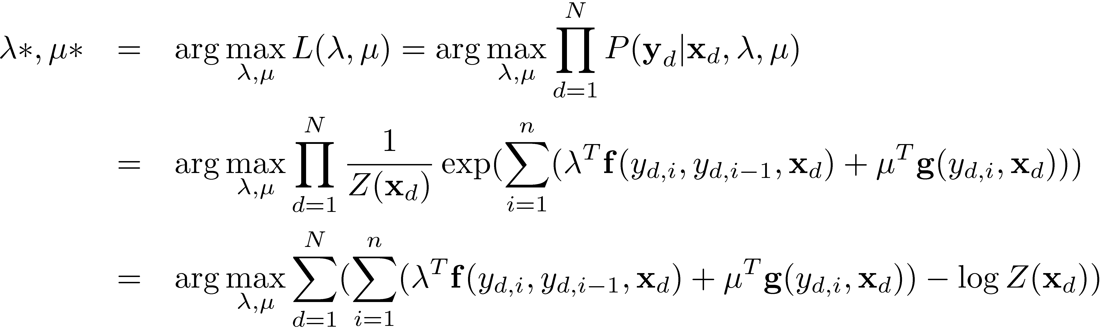
CRF learning
Given {(x_{d}, y_{d})}_{d=1}^{N}, find λ*, μ* such that
Computing the gradient w.r.t λ:
Gradient of the log-partition function in an exponential family is the expectation of the sufficient statistics.

Slide 19
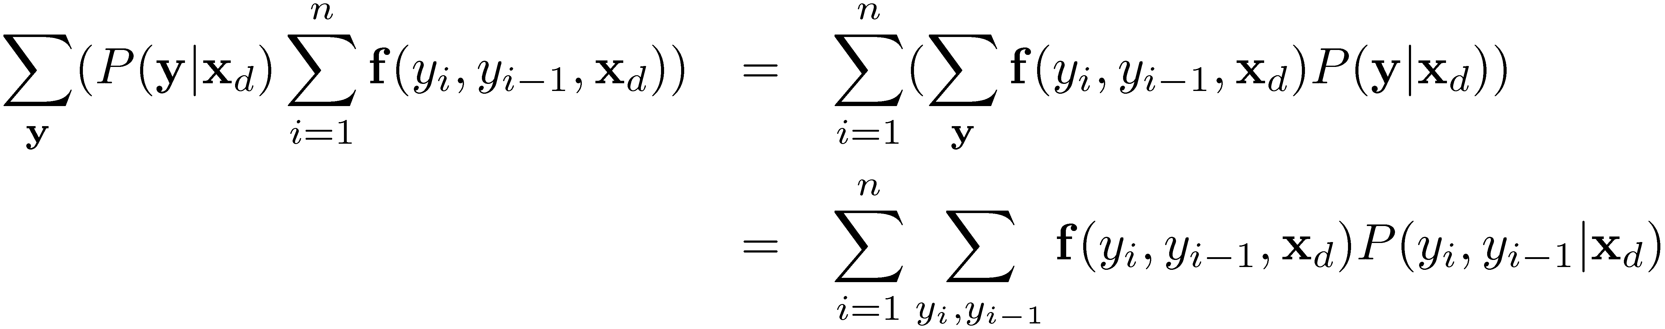
CRF learning
Computing the model expectations:
  Requires exponentially large number of summations: Is it intractable?
Tractable!
  Can compute marginals using the sum-product algorithm on the chain
Expectation of f over the corresponding marginal probability of neighboring nodes!!

Slide 20
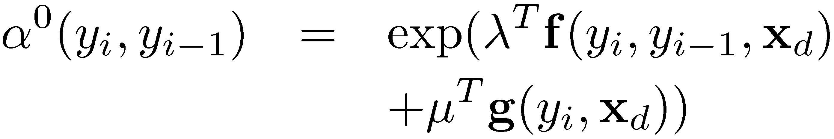
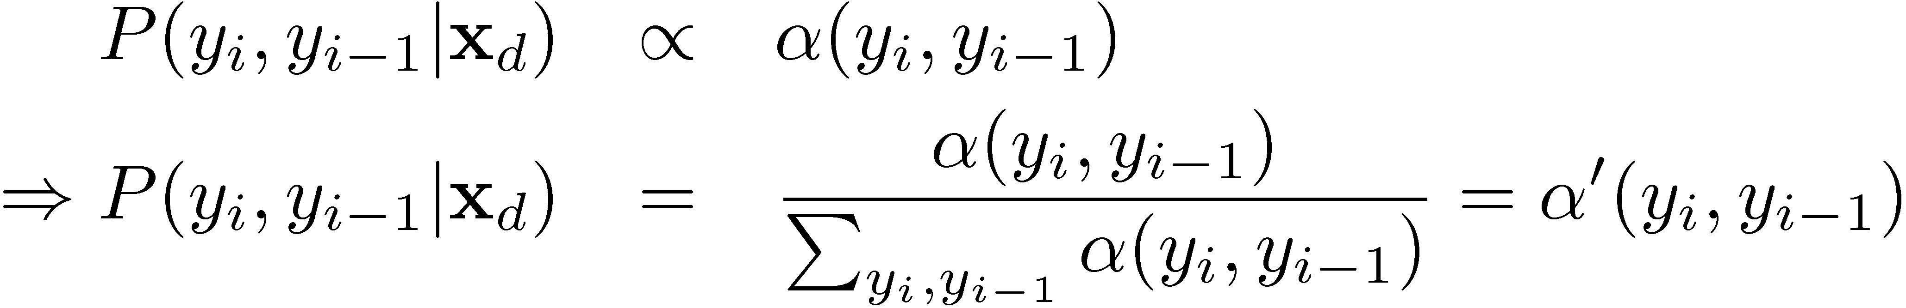
CRF learning
Computing marginals using junction-tree calibration:
Junction Tree Initialization:
After calibration:
Y₁
Y₂
…
…
…
Y_{n}
x_{1:n}
Y₁,Y₂
Y₂,Y₃
…….
Y_{n-2}
Y_{n-2},Y_{n-1}
Y_{n-1}
Y_{n-1},Y_{n}
Y₂
Y₃
Also called
forward-backward algorithm

Slide 21
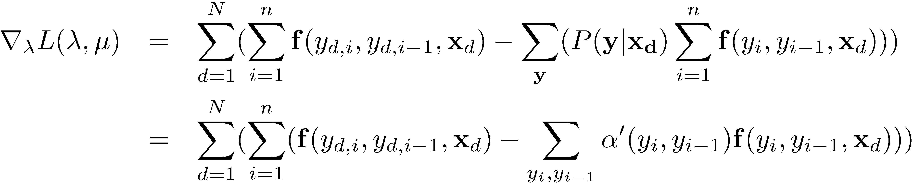
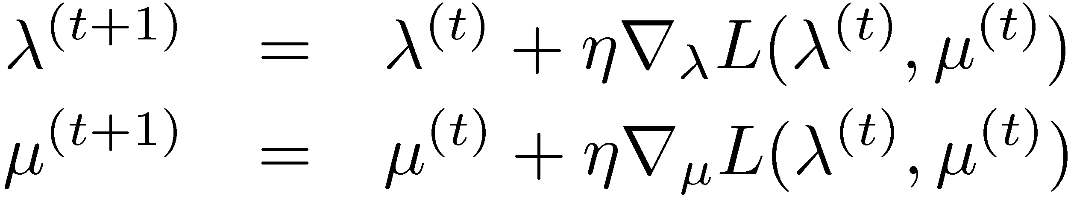
CRF learning
Computing feature expectations using calibrated potentials:
Now we know how to compute r_{λ}L(λ,μ):
Learning can now be done using gradient ascent:

Slide 22
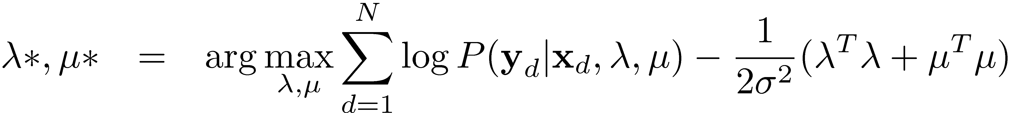
CRF learning
In practice, we use a Gaussian Regularizer for the parameter vector to improve generalizability
In practice, gradient ascent has very slow convergence
  Alternatives:
    Conjugate Gradient method
    Limited Memory Quasi-Newton Methods

Slide 23
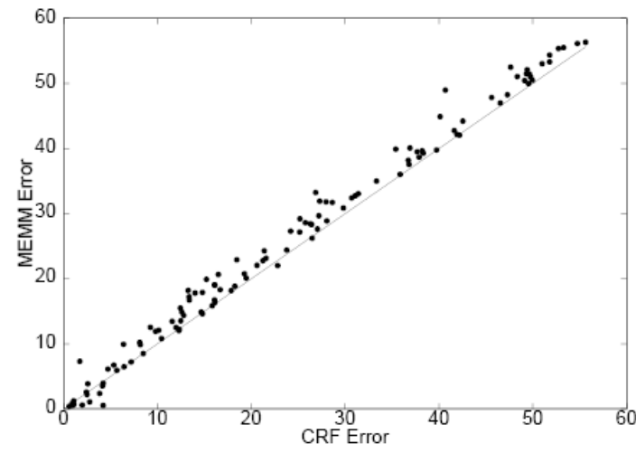
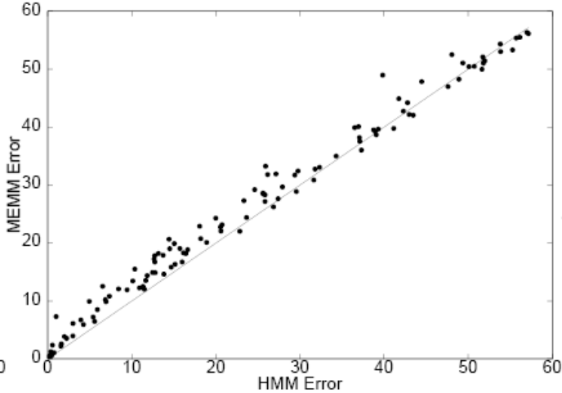
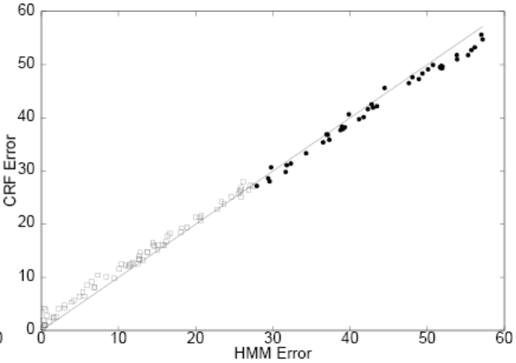
CRFs: some empirical results
Comparison of error rates on synthetic data
MEMM error
MEMM error
CRF error
HMM error
Data is increasingly higher order in the direction of arrow
CRF error
CRFs achieve the lowest error rate for higher order data
HMM error

Slide 24
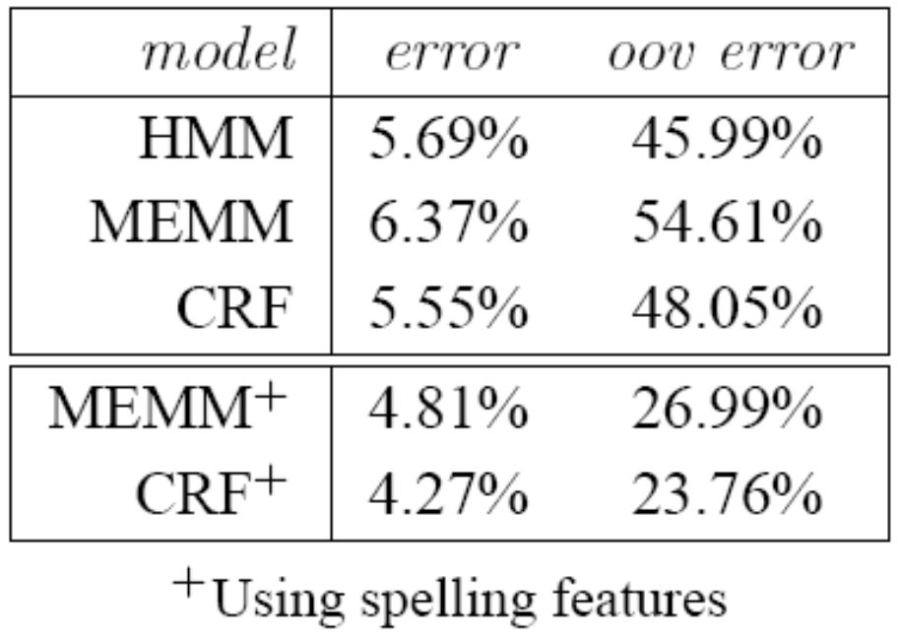
CRFs: some empirical results
Parts of Speech tagging
  Using same set of features: HMM >=< CRF > MEMM
  Using additional overlapping features: CRF⁺ > MEMM⁺ >> HMM

Slide 25
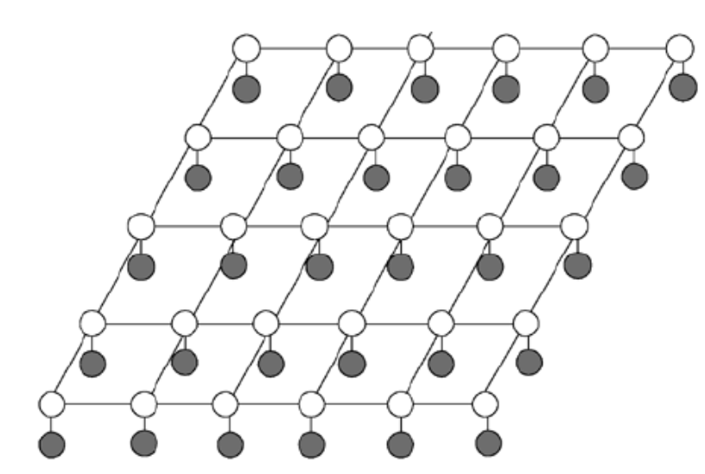
Other CRFs
So far we have discussed only 1-dimensional chain CRFs
  Inference and learning: exact
We could also have CRFs for arbitrary graph structure
  E.g: Grid CRFs
  Inference and learning no longer tractable
  Approximate techniques used
    MCMC Sampling
    Variational Inference
    Loopy Belief Propagation
  We will discuss these techniques in the future

Slide 26
Summary
Conditional Random Fields are partially directed discriminative models
They overcome the label bias problem of MEMMs by using a global normalizer
Inference for 1-D chain CRFs is exact
  Same as Max-product or Viterbi decoding
Learning also is exact
  globally optimum parameters can be learned
  Requires using sum-product or forward-backward algorithm
CRFs involving arbitrary graph structure are intractable in general
  E.g.: Grid CRFs
  Inference and learning require approximation techniques
    MCMC sampling
    Variational methods
    Loopy BP

